Slide 1
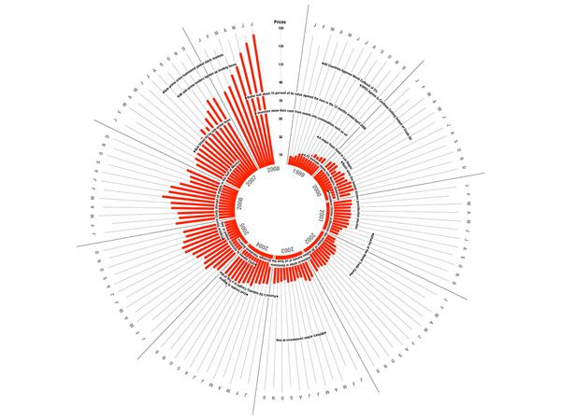
Data Visualization Techniques
MSc in Data Analytics Lecturer: Noel Cosgrave

Slide 2
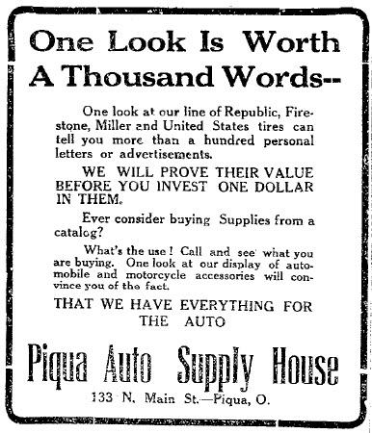

A Picture is Worth a Thousand Words
Napoleon:
Un bon croquis vaut mieux qu'un long discours (A good sketch is better than a long speech)
Image source: Wikimedia Commons.
Notes:
Source: https://en.wikipedia.org/wiki/A_picture_is_worth_a_thousand_words
Newspaper ad from 1913 – thought to be first use of phrase.

Slide 3

Perceptual Edge’s Graph Design I.Q. Test
This test will ask you 10 questions to determine how well you understand the principles of good table and graph design.
First time through, we just record our answers with no discussion.
Pencils at the Ready!
http://www.perceptualedge.com/files/GraphDesignIQ.html
Notes:
Via Stephen Few (with permission)

Slide 4

Getting Started
Understand the data you are trying to visualize, including its size and cardinality
Determine what you are trying to visualize and what kind of information you want to communicate
Know your audience and understand how it processes visual information
Use a visual that conveys the information in the best and simplest form for your audience.
Notes:
What Is Data Cardinality?
Cardinality is the uniqueness of data values contained in a column.
High cardinality means there is a large percentage of unique values (e.g., bank account numbers, because each item should be unique)
Low cardinality means a column of data contains a large percentage of repeat values (such as a “gender” column)
For point 2 above…
BABOK – Collaborative Gaming (Product Box Exercise). Participants construct a box for the product as if it was being sold in a retail store. Used to identify features of a product that help drive interest in the marketplace.

Slide 5
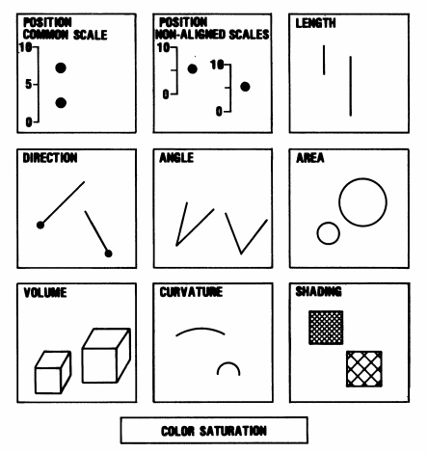
Visual Ratios
There are many kinds of visual ratios and some are more effective than others. Cleveland and McGill (1984) gave us the order of effectiveness of interpretation for these ratios:
Position on a common scale
Position on non-aligned scales
Length
Direction
Angle
Area
Volume
Curvature
Shading
Colour saturation
Cleveland, W.S. and McGill, R., 1984. Graphical perception: Theory, experimentation, and application to the development of graphical methods. Journal of the American Statistical Association, 79(387), pp.531-554.
Notes:
Cleveland & McGill’s visual ratios.

Slide 6
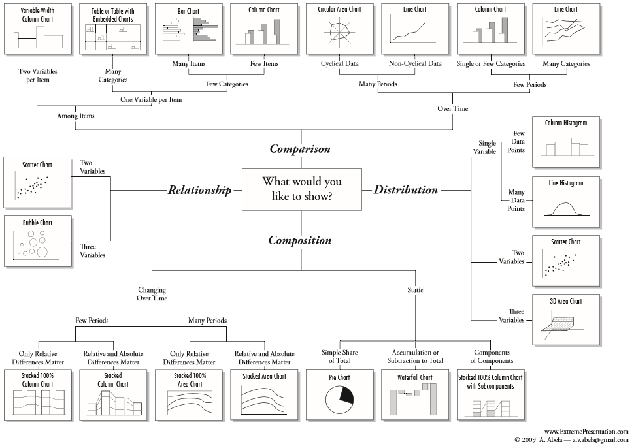
Chart Suggestions - A Thought-Starter
Source: http://extremepresentation.typepad.com/files/choosing-a-good-chart-09.pdf

Slide 7
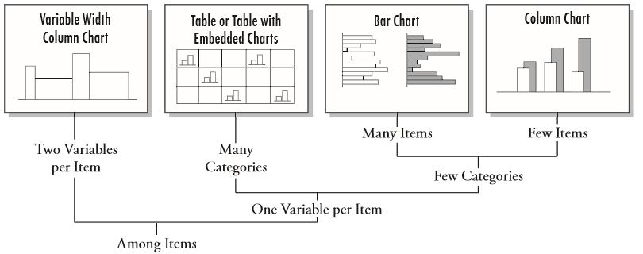
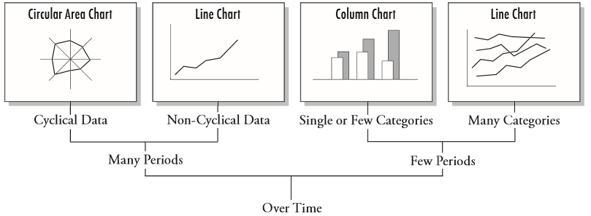
Comparison
Source: http://extremepresentation.typepad.com/files/choosing-a-good-chart-09.pdf

Slide 8
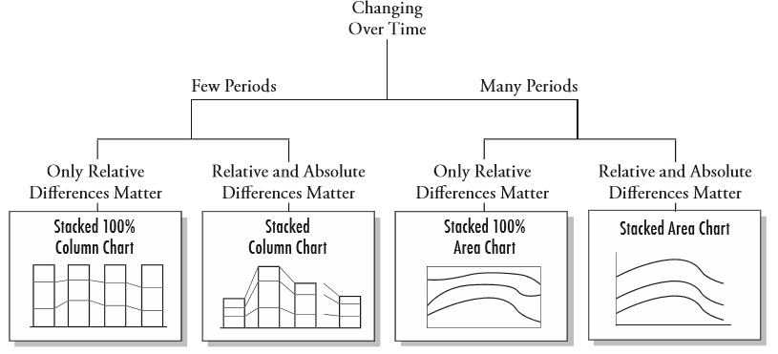
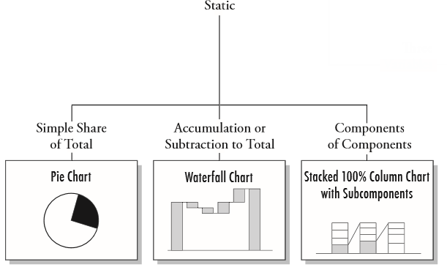
Composition
Source: http://extremepresentation.typepad.com/files/choosing-a-good-chart-09.pdf

Slide 9
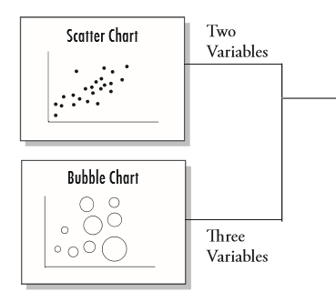

Relationship
Source: http://extremepresentation.typepad.com/files/choosing-a-good-chart-09.pdf

Slide 10
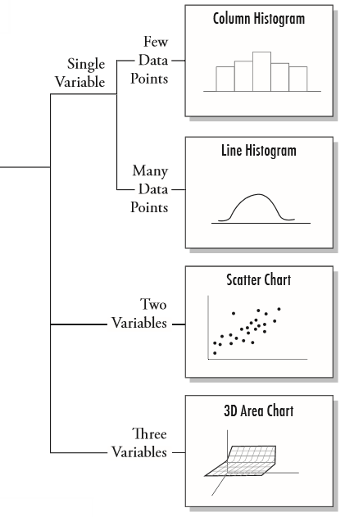
Distribution
Source: http://extremepresentation.typepad.com/files/choosing-a-good-chart-09.pdf

Slide 11
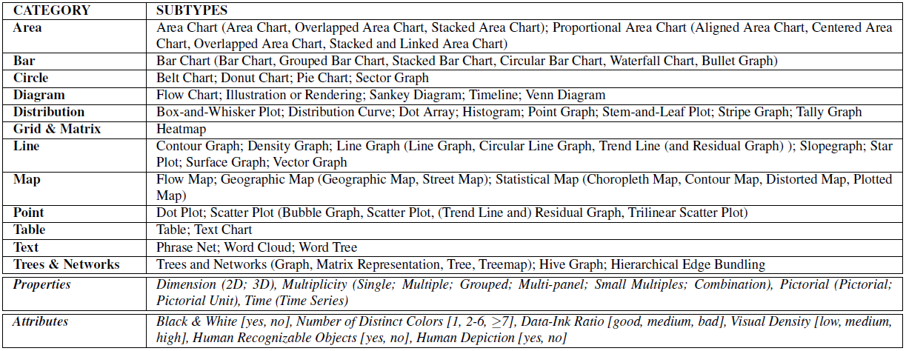
A visualisation taxonomy
Borkin, M.A., Vo, A.A., Bylinskii, Z., Isola, P., Sunkavalli, S., Oliva, A. and Pfister, H., 2013. What makes a visualization memorable?. IEEE Transactions on Visualization and Computer Graphics, 19(12), pp.2306-2315.

Slide 12


Exercise: Understand Data (Basics)
Descriptives
Excel
R
Basic Charts
Tableau
Excel
SPSS
R
Moodle: MetOfficeData.csv
Create your own: http://www.met.ie/climate-request
Share on Google Slides (optional).
Notes:
Allow at least one hour for this exercise.
Met Office Data
maxtp: - Maximum Air Temperature (C)
mintp: - Minimum Air Temperature (C)
mnmax: - Mean Maximum Temperature (C)
mnmin: - Mean Minimum Temperature (C)
rain: - Precipitation Amount (mm)
gmin: - Grass Minimum Temperature (C)
wdsp: - Mean Wind Speed (knot)
mxgt: - Highest Gust (knot)
sun: - Sunshine duration (hours)

Slide 13
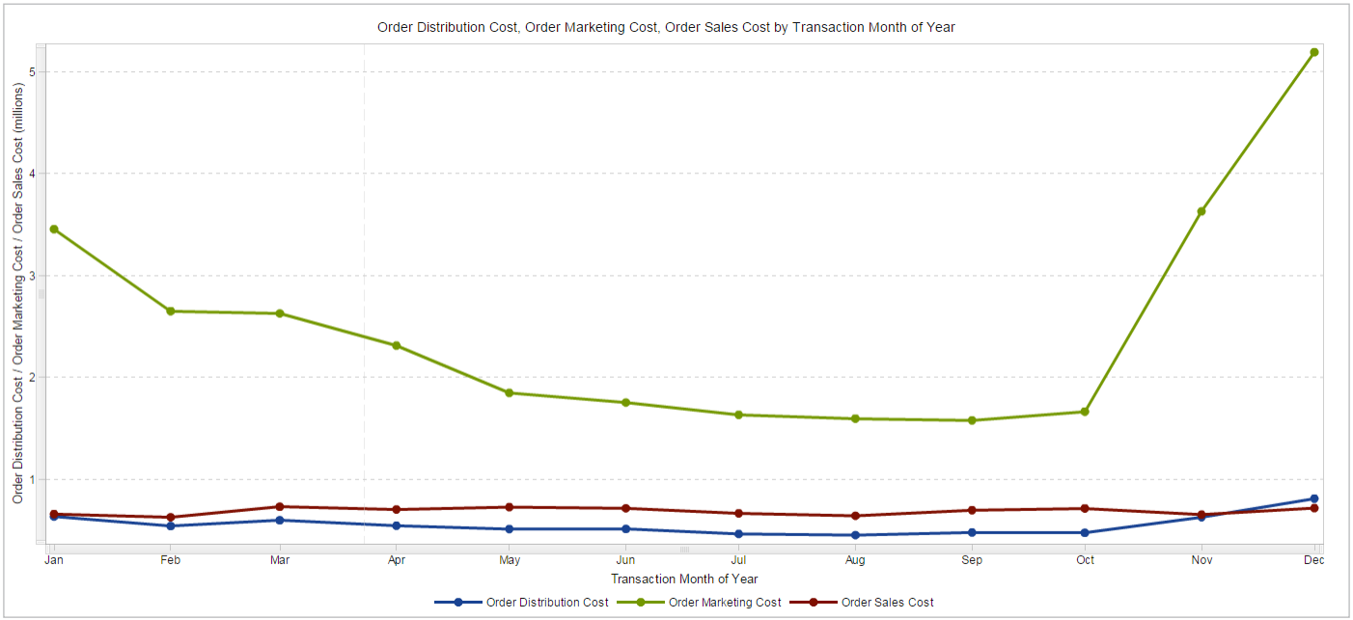

Charting: The Basics
Line Chart
Notes:
Line graphs show the relationship of one variable to another. Shown here, multiple category line graphs compare multiple items over the same time period.

Slide 14
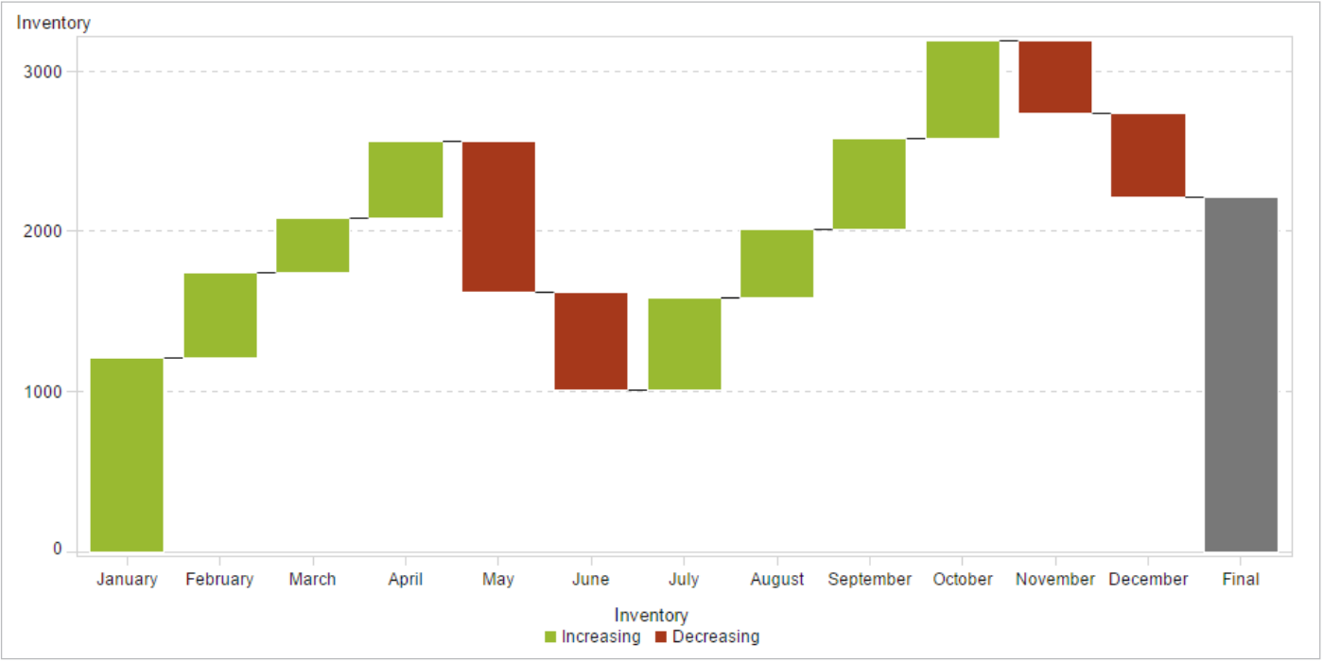
Charting: The Basics
Bar Chart
Notes:
Bar charts can be configured with either vertical or horizontal bars, with the length or height of each bar representing the value.
This bar graph – a waterfall chart – shows how the initial value of a measure increases or decreases during a series of operations or transactions.

Slide 15
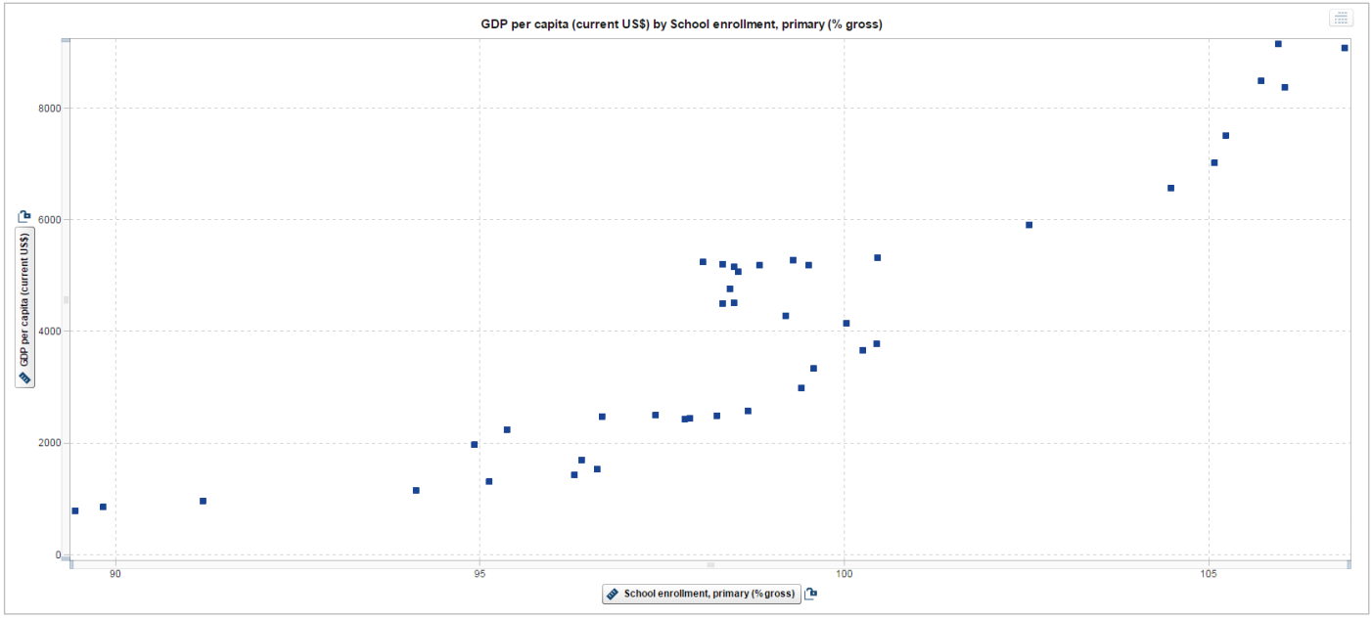
Charting: The Basics
Scatter Plots
Notes:
Scatter plots can help you gain a sense of how spread out the data might be or how closely related the data points are. They can also quickly identify patterns present in the distribution of the data.
A scatter plot is a good way to visualize relationships in data.

Slide 16
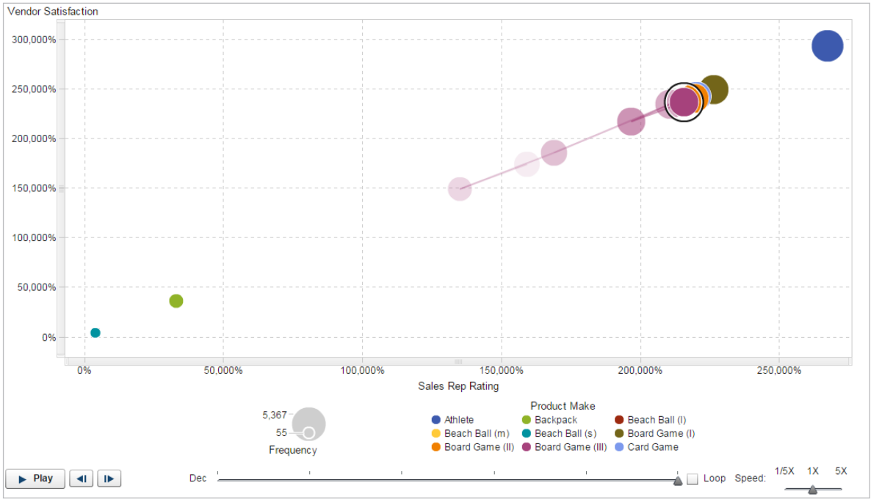
Charting: The Basics
Bubble Plots
Notes:
Bubble plots are a variation of scatter plots. They’re especially useful for data sets with dozens to hundreds of values or when the values differ by several orders of magnitude.

Slide 17
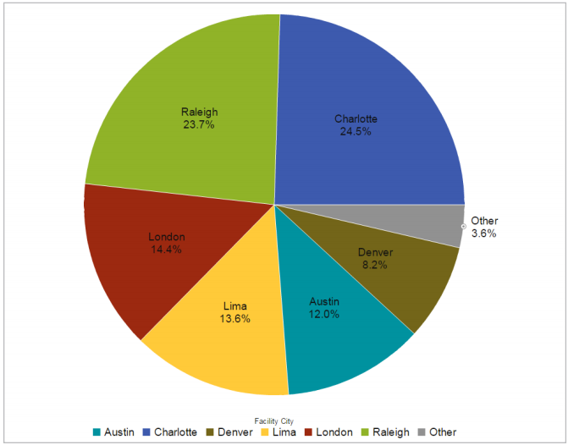
Charting: The Basics
Pie Charts
Notes:
Pie charts are most effective when there are limited components and when text and percentages are included to describe the content.
A pie chart helps you compare the percentages of different components.

Slide 18
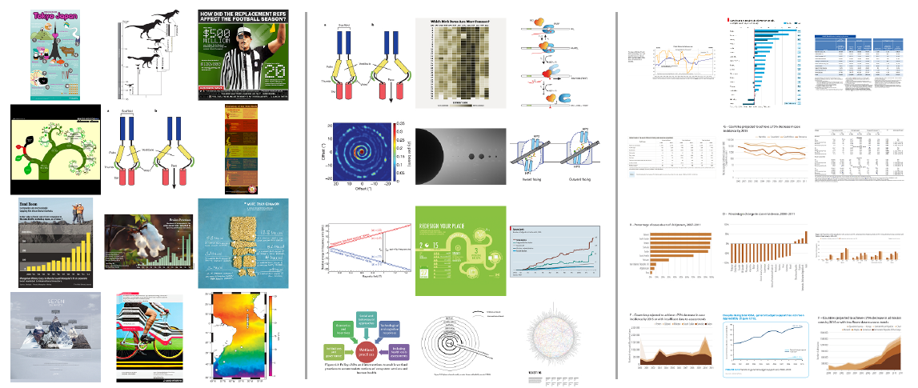
What makes a visualisation memorable?
Memorability
Read This!
Memorability
Addition of so called “Chart Junk” can improve memorability, but do they interfere with understanding?
Borkin, M.A., Vo, A.A., Bylinskii, Z., Isola, P., Sunkavalli, S., Oliva, A. and Pfister, H., 2013. What makes a visualization memorable?. IEEE Transactions on Visualization and Computer Graphics, 19(12), pp.2306-2315.

Slide 19
Beyond Memorability
Titles and supporting text should convey the message of a visualisation
If used appropriately, pictograms do not interfere with understanding and can improve recognition
Redundancy helps effectively communicate the message
A memorable visualisation is also an effective one
“Put a title on your graph, annotate the important things, label your axes, pick appropriate visual encodings, ..., people will understand your visualisations”
Michelle Borkin, Northeastern University
Interviewed on Data Stories
http://datastori.es/113-what-makes-a-visualization-memorable-with-michelle-borkin/
Borkin, M.A., Bylinskii, Z., Kim, N.W., Bainbridge, C.M., Yeh, C.S., Borkin, D., Pfister, H. and Oliva, A., 2016. Beyond memorability: Visualization recognition and recall. IEEE transactions on visualization and computer graphics, 22(1), pp.519-528.
Read This!

Slide 20

“Small” Data – Easy!
New challenges to data visualization
Image source: https://thombartley.wordpress.com/2014/05/08/big-social-vs-little-social/

Slide 21

Visualizing Big Data
Big data brings new challenges to visualization:
Speed of data
Size of Data
Diversity of data
Cardinality
Move beyond comfort zone because of:
Volume
Variety
Velocity
Image source: https://rc.fas.harvard.edu/how-big-is-big-data/
Notes:
Volume refers to the size of the data.
Variety describes whether the data is structured, semi-structured or unstructured.
Velocity is the speed at which data pours in and how frequently it changes.

Slide 22
How big is “Big Data”?
“Datasets whose size is beyond the ability of typical database software tools to capture, store, manage, and analyze“ (McKinsey, 2011)
Currently, only 23% of collected data has been deemed beneficial, and of that only 3% is tagged and only 0.5% has been analyzed
But if the data can be used, McKinsey estimates retailers could increase operating margin by 60% and national U.S. healthcare expenditures could be reduced by 8% per year
Source: FAS Research Computing, Harvard University.
Notes:
Source of definition: http://www.mckinsey.com/business-functions/digital-mckinsey/our-insights/big-data-the-next-frontier-for-innovation

Slide 23

Big Data - Value
One of the major challenges of big data is how to extract value from it
We know how to
create it
store it
But we fall short when it comes to
analysis
synthesis
Notes:
Analysis – break down
Synthesis – put together again

Slide 24
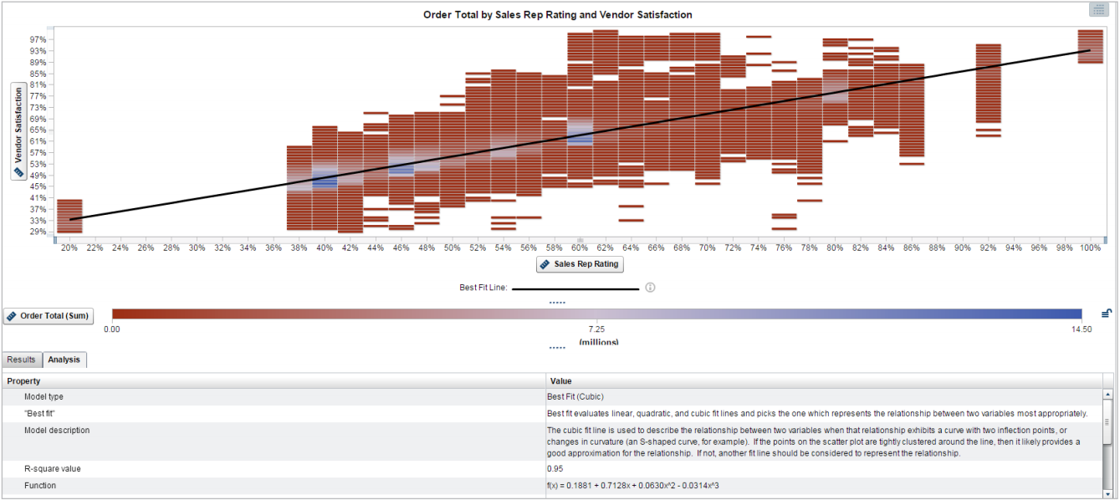
Visualizing Big Data
Handling large volumes
Notes:
SAS Visual Analytics provides autocharting and “what does it mean” pop-ups to help nontechnical users create and understand data visualizations. The “what does it mean” pop-up (bottom) explains that the correlation shown in this binned box plot indicates a strong linear relationship between Sales Rep Rating and Vendor Satisfaction.

Slide 25
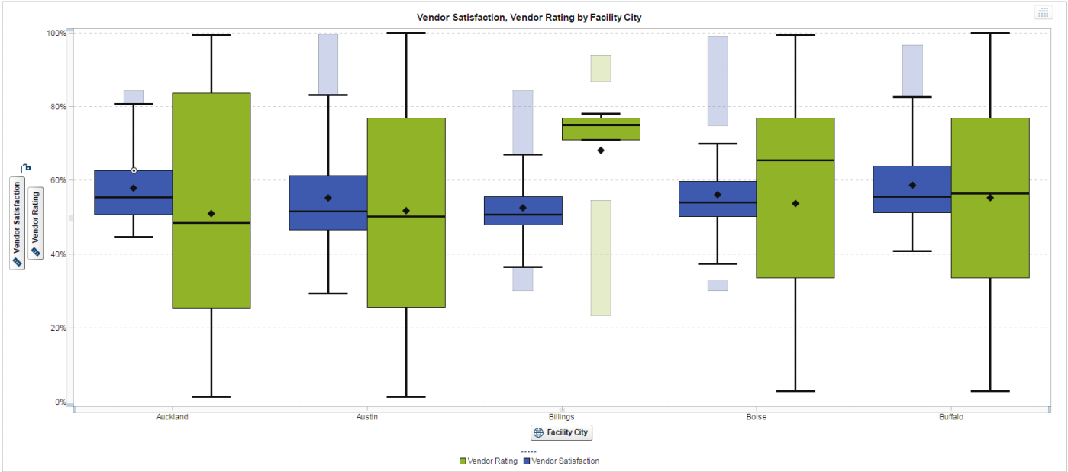
Visualizing Big Data
Box Plots
Notes:
Box plots are another example of how the volume of data can affect the visual being shown. A box plot is a graphical display of five statistics (the minimum, lower quartile, median, upper quartile and maximum) that summarize the distribution of a set of data. The lower quartile (25th percentile) is represented by the lower edge of the box, and the upper quartile (75th percentile) is represented by the upper edge of the box. The median (50th percentile) is represented by a central line that divides the box into sections. Extreme values are represented by whiskers that extend out from the edges of the box. Usually, these display well when using big data (see Fig above).
Often, box plots are used to understand the outliers in the data. Generally speaking, the number of outliers in the data can be represented by 1 percent to 5 percent of the data. With traditionally sized data sets, viewing this proportion of the data is not necessarily hard to do. However, when you are working with massive amounts of data, viewing 1 percent to 5 percent of the data is challenging.
For example, if you were working with a billion rows of data, the outliers would represent 10 million data points. If you bin the results and show a box plot with whiskers (Figure 8), you can view the distribution of the data and see the outliers – all calculated quickly on big data.

Slide 26
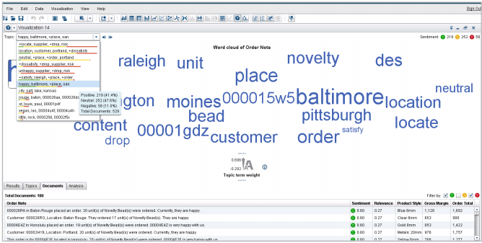
Visualizing Big Data
Word Clouds
Notes:
A word cloud shows the words or phrases associated with a topic.
For example, you could use the topic cloud to categorize customer comments on Twitter about your products or services and then click on a topic to drill down to see the actual comments.

Slide 27
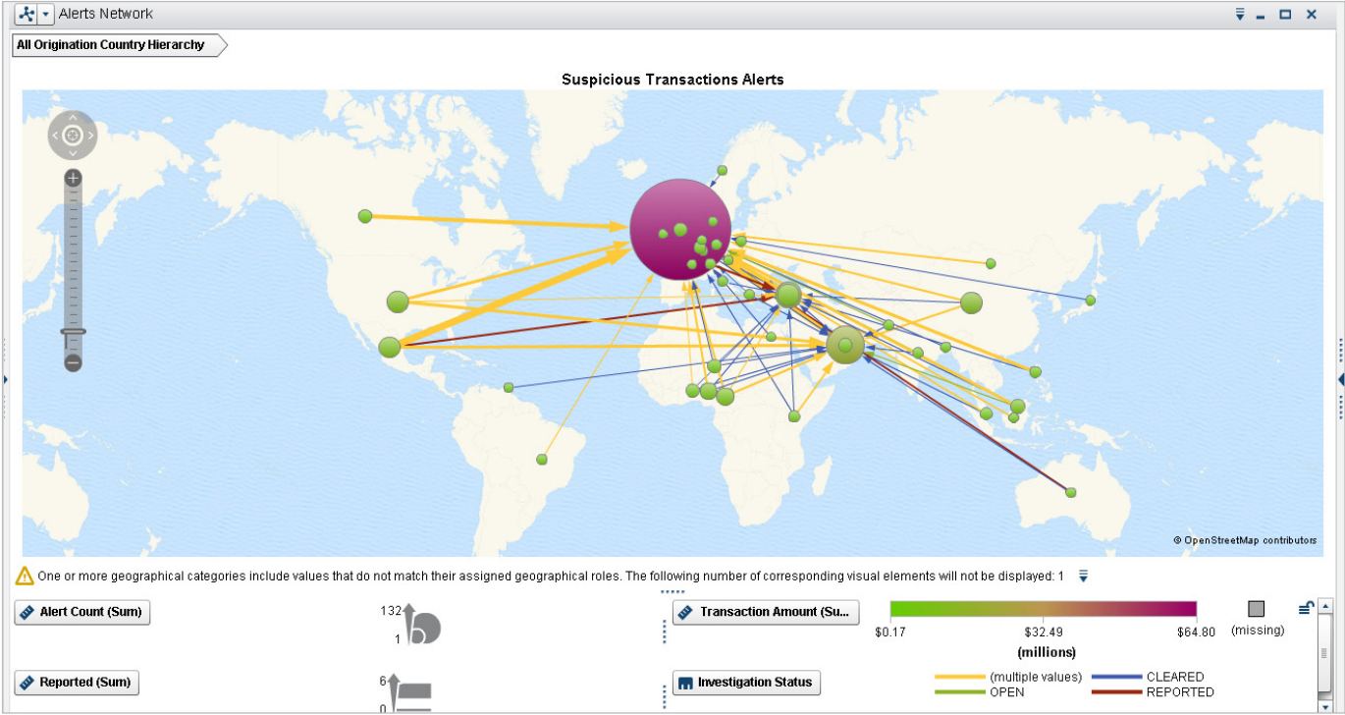
Visualizing Big Data
Network Diagram
Notes:
Network diagrams explore relationships within a data set, including connections across geographic areas.
Network diagrams can be used in many applications and disciplines. For example, businesses analyze social networks to understand their interactions with customers, while counterintelligence and law enforcement might map a clandestine or covert organization such as an espionage ring, an organized crime family or a street gang. You can also superimpose the network diagram on a map, for example, to show the relationship or product sales across geographic areas.

Slide 28
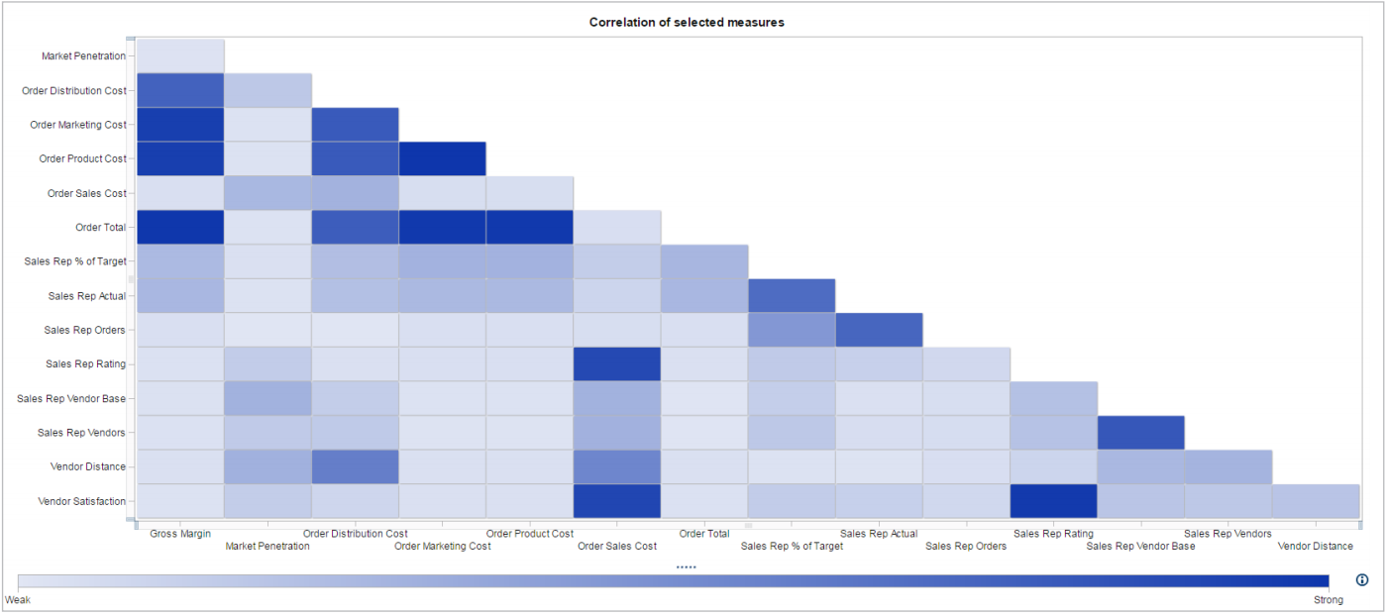
Visualizing Big Data
Correlation Matrix
Notes:
A correlation matrix combines big data and fast response times to quickly identify which variables among the millions or billions are related. It also shows how strong the relationship is between the variables.
In this correlation matrix, darker boxes indicate a stronger correlation; lighter boxes indicate a weaker correlation. You can double-click on a box for further details.

Slide 29
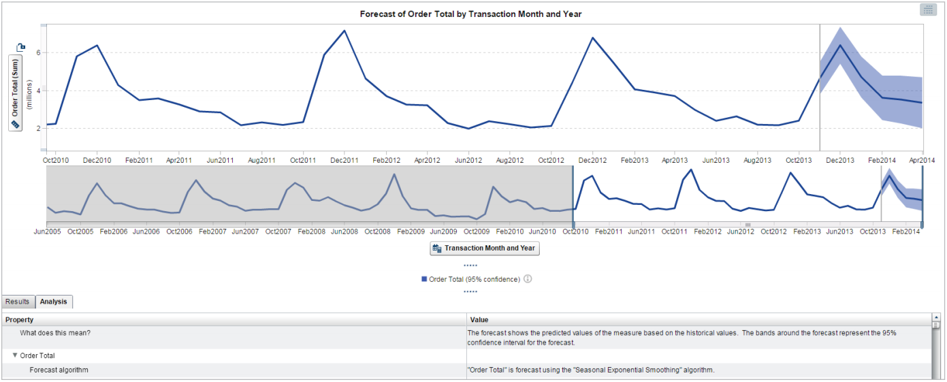
Visualizing Big Data
Forecasting
Notes:
With automated forecasting capabilities, SAS Visual Analytics chooses the most appropriate forecasting algorithm for the selected data. “What does it mean” pop-ups (bottom of screen) provides explanations of analytic functions and data correlations, so even nontechnical users can understand what the data means.

Slide 30
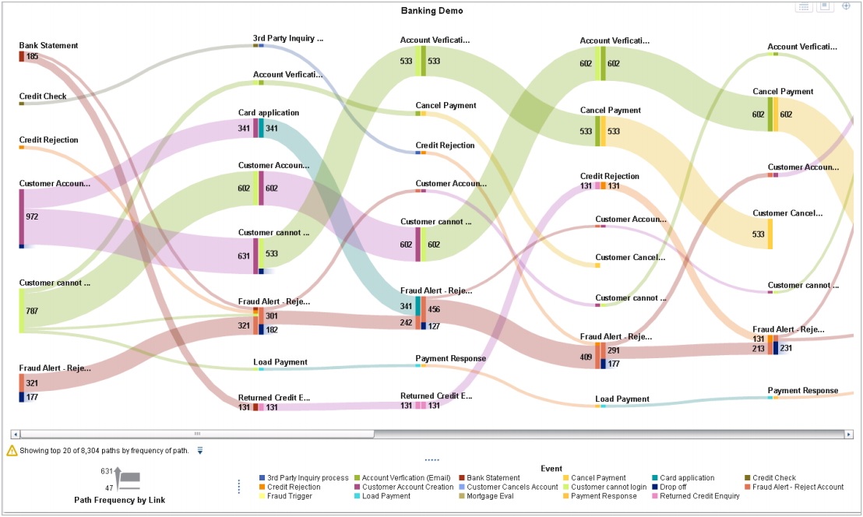
Visualizing Big Data
Sankey Diagram
Notes:
Sankey diagrams use path analysis to show the dynamics of how transactions move through a system (e.g., how customers navigate your website).
A Sankey diagram displays a series of linked nodes, where the width of each node indicates the frequency of the link or value of the measure.

Slide 31

Visualizing Big Data
Fun & Challenging!
However…
Wrong visualization?
Audience?
Consider more than one visual?
Important
How do viewers process visual information?
Do you understand the composition and relationships in your data?
Poor Data Visualization Ahead
Image source: http://www.clipartbro.com/clipart-image/warnign-sign-clipart-26760
Notes:
Visualizing your data can be both fun and challenging. It is much easier to understand information in a visual compared to a large table with lots of rows and columns. However, with the many visually exciting choices available, it is possible that the visual creator may end up presenting the information using the wrong visualization. In some cases, there are specific visuals you should use for certain data. In other instances, your audience may dictate which visualization you present. In the latter scenario, showing your audience an alternative visual that conveys the data more clearly may provide just the information that’s needed to truly understand the data.

Slide 32
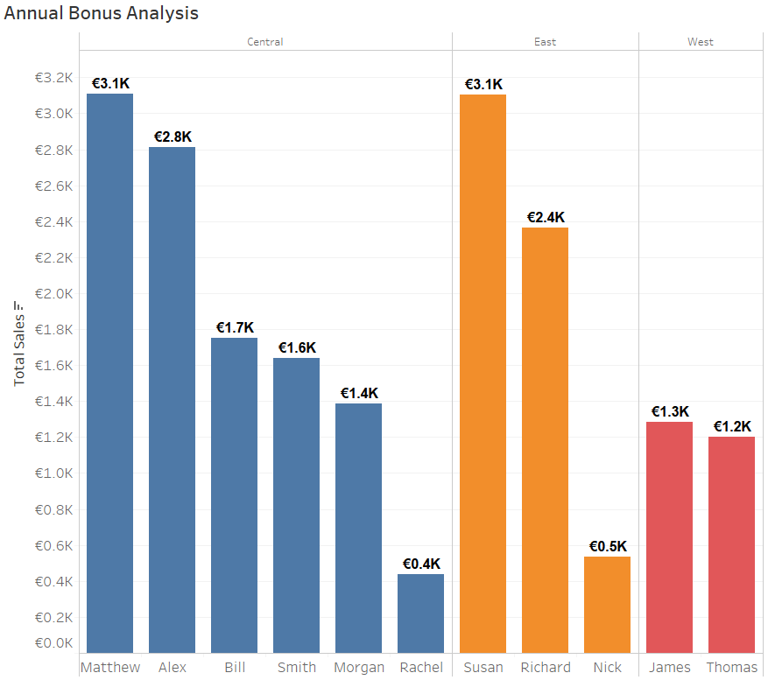
Exercise: Tableau
Office Supplies Sales Data
File in Moodle (csv)
Step-by-step guide (Moodle)

